Slide 1
Sanofi logo intro

Slide 2
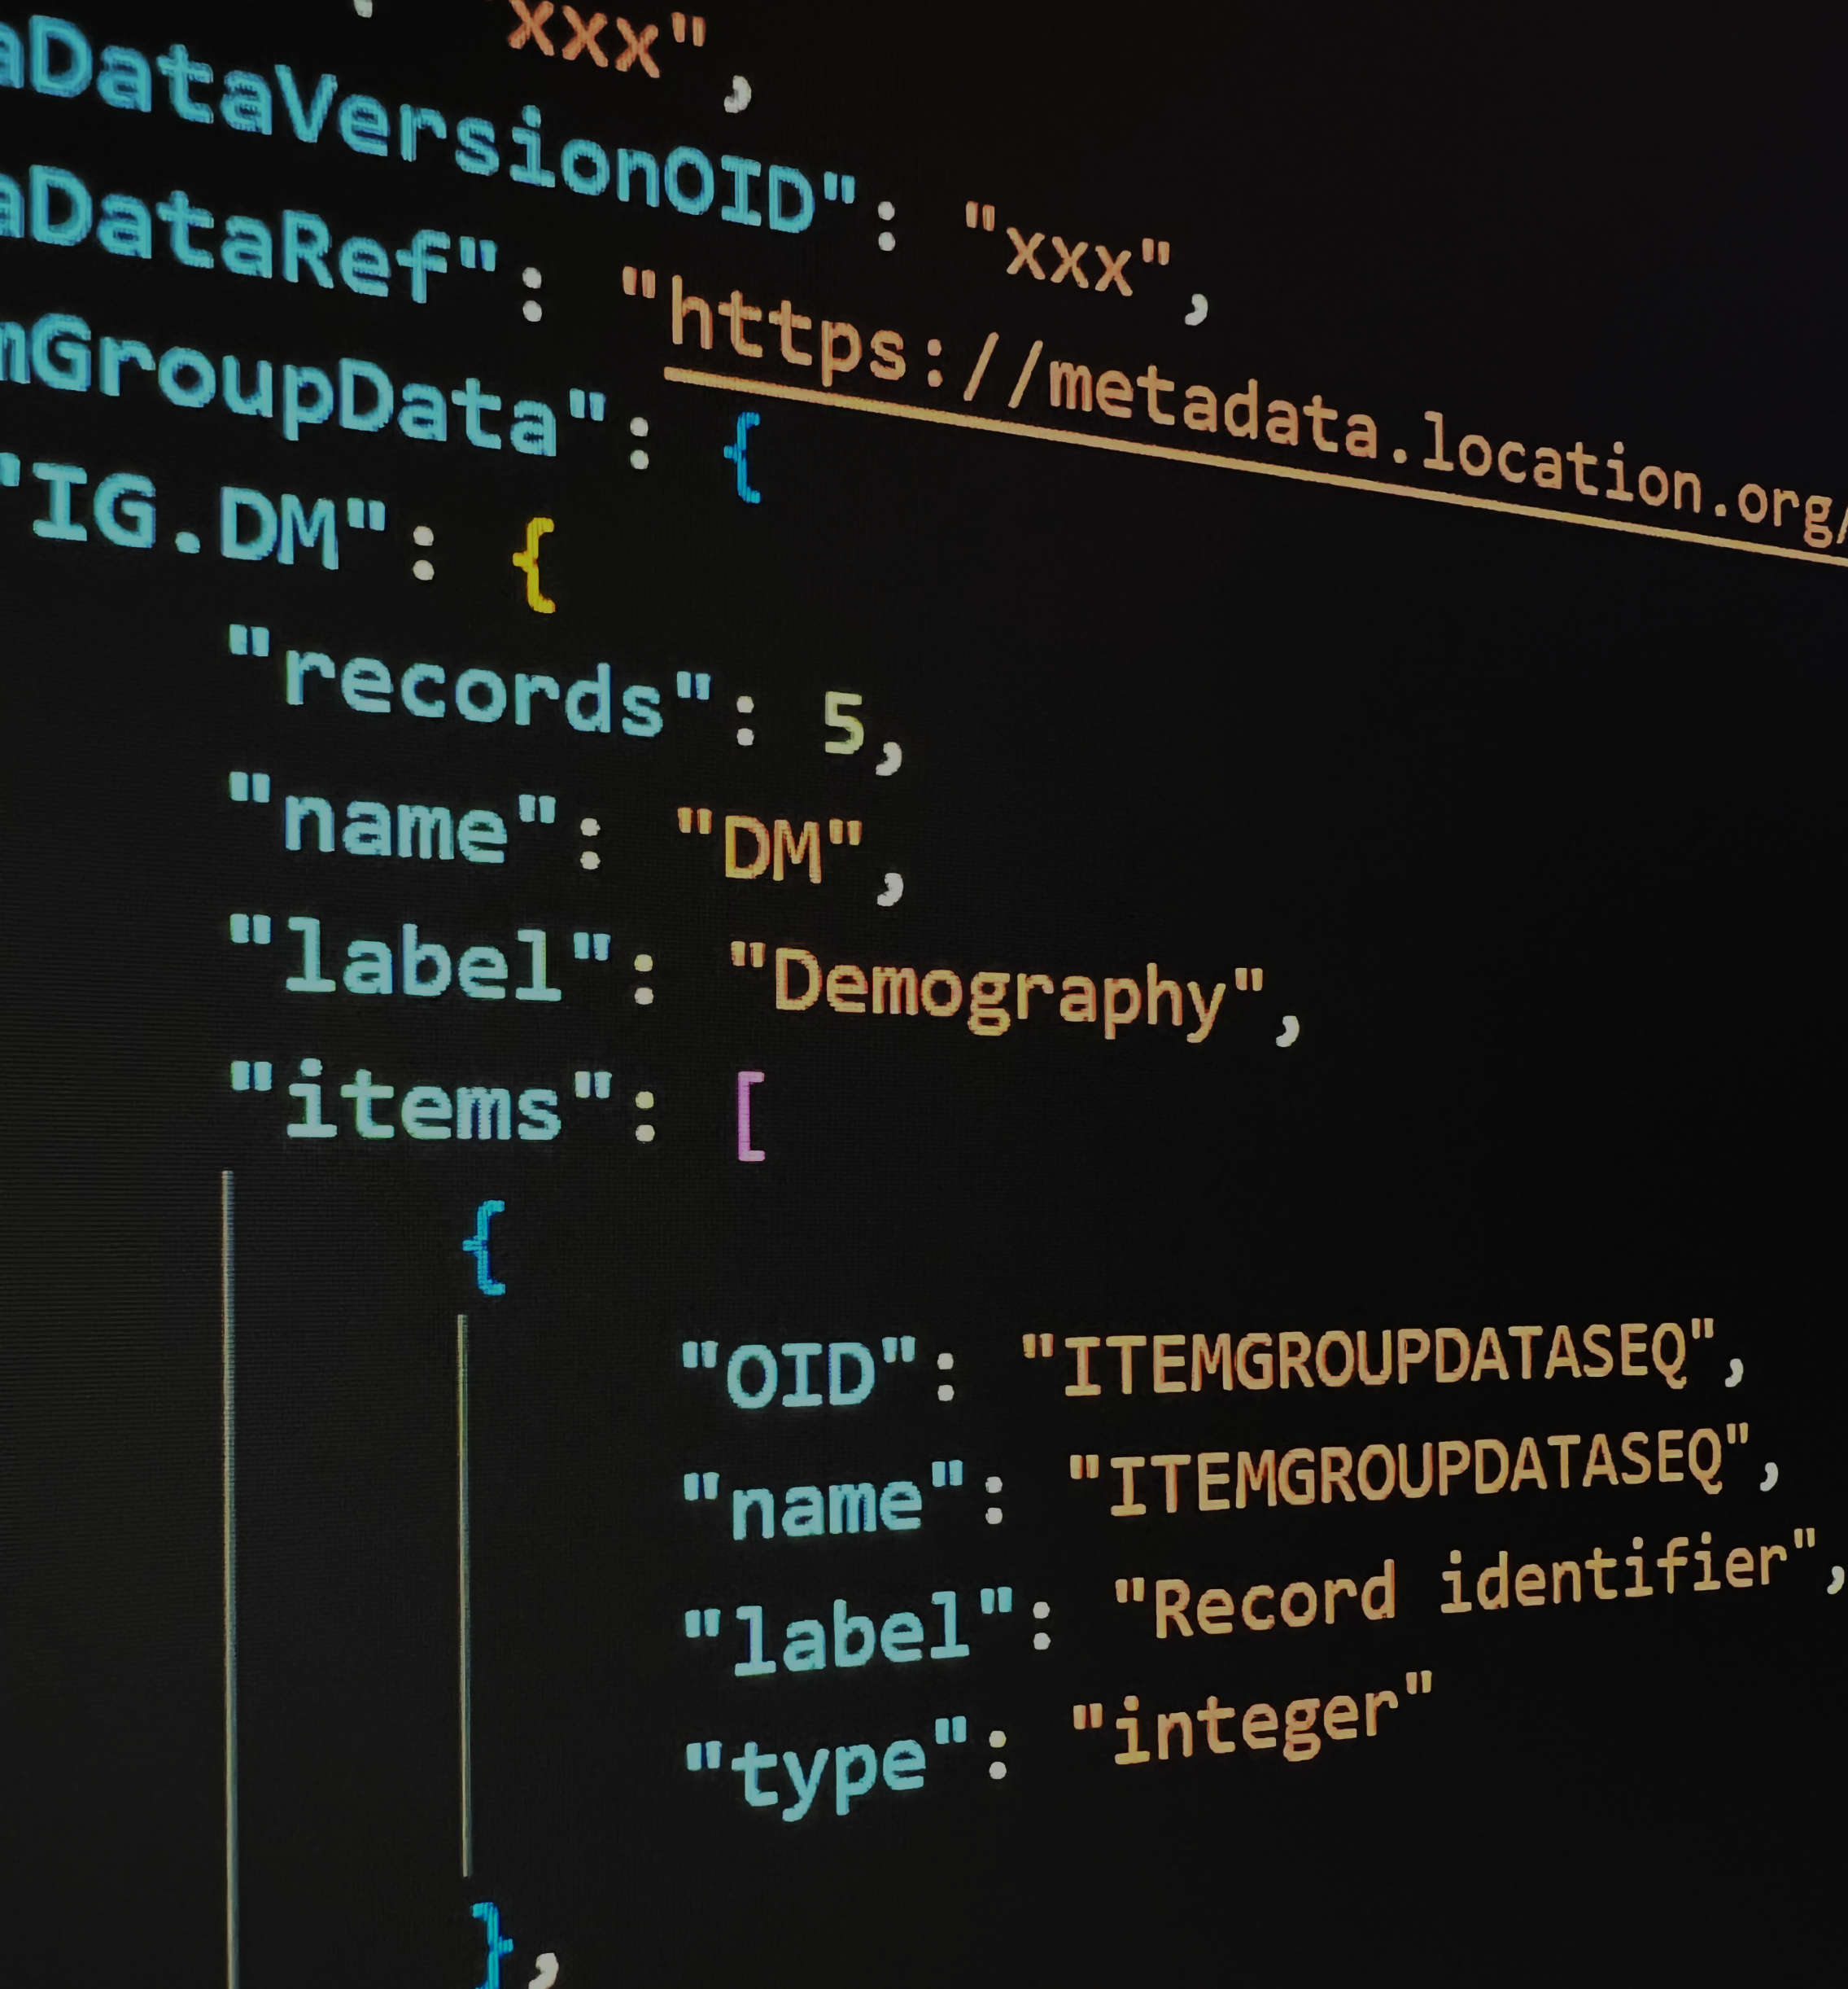
From XPT to Dataset-JSON as Alternative Transport Format for Regulatory Submission
Huan Lu, Neo Yang
This Photo by Huan Lu Author is licensed under Sanofi

Slide 3
The views and opinions expressed in this presentation are those of the author(s) and do not necessarily reflect the official policy or position of China PharmaRUG 2024

Slide 4

Huan LU 陆欢
Associate Manager, Statistical Programming
5+ years in clinical trial research in data science, clinical data sharing and transparency and innovation development in analytics and reporting tools for submission.
Graduated from George Washington University majoring in Mathematics, Applied Mathematics and Statistics, be with Sanofi since 2018 in Clinical Science and Operation department.

Slide 5

Neo YANG 阳桢寰
Statistical Programmer, Statistical Programming
2+ years across clinical trial data research and innovative analysis tool development, committed to open-source clinical report , data sharing & transparency and AI embed tools for submission.
Graduated from Chongqing Medical University and Shanxi Medical University majoring in Biostatistics, be with Sanofi since 2023 in Clinical Science and Operation department.

Slide 6
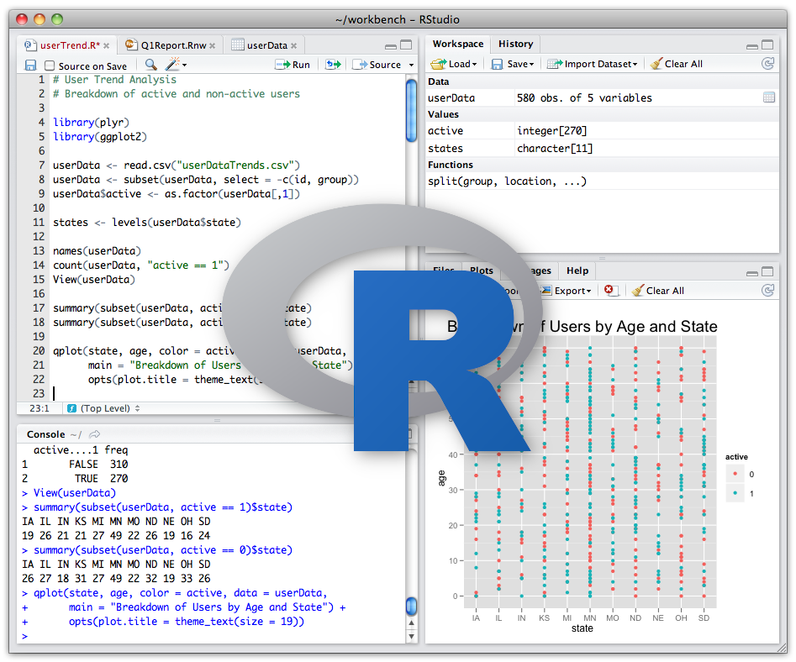
Agenda
📖
Background
Why change to Dataset-JSON?
📍
Roadmap
By PHUSE Working Group
🚧
Feasibility in R
Easy-peasy?
🎬
Demo
With an User-friendly UI
💡
Conclusion
Strategy for Future Development

Slide 7
📖 Background

Slide 8
Limitations of XPTv5 vs JSON
Interoperability and Openness
Dataset Size
Numeric limitations
Character limitations
String limitations
Column limitations
Lack of metadata extensibility
Reference: Showcasing limitations of XPTv5 vs JSON

Slide 9
Why we change to JSON?
Dataset JSON is a widely accepted data format that will streamline data exchange between organizations. Moving to dataset JSON will prepare us for the current digital world and will enable our industry to more accurately, completely, and efficiently represent our clinical research data, allowing us to better serve our patients/customers. It supports current data standards but also allows for standards to evolve and removes current limitations imposed by XPT format. Dataset JSON will save time, hardware cost, increase performance, and is easily transferable between systems. All this will save cost and time.
Reference: {pharamvese}, CDISC Analysis Results Standards (ARS)

Slide 10
When the story begins?
PhUSE initiated The PhUSE Alternate Transport Format Project following discussions between the FDA and PhUSE representatives to come up with some suggestions for the replacement of the venerable (but seriously outdated) SAS® Version 5 (V5) Transport format (hereafter referred to as SAS V5 transport format). This format is the standard for the submission of clinical, nonclinical and analysis datasets to the FDA and other regulatory agencies.
Reference: Transport for the Next Generation Version 1.0

Slide 11
📍 Roadmap

Slide 12

Roadmap
Tool Vendor: 11+
CRO: 3+
Biomatrix Service Provider: 2+
Regulatory: 6+
Pharmaceutical Company: 13+
Q2 2023
PHUSE Team formation
Engaged with collaboration
partners (CDSIC, FDA etc.)
Oct 2023
Kickoff Sub teams
Business Requirements
Technical Requirements
Pilot with FDA
Strategy for Future
Development
Feb 2024
Review draft deliverables
Working Sessions
At PHUSE US Connect
2025
Goal
Regulatory Guidance’s
updated to accept JSON as
a drop in alternative to XPT
Jan 2024
Webinar
Dataset JSON Project Update
Sub team readouts
STAKEHOLDER INTERVIEW
DEADLINE
JAN 31, 2024
Sep 2023
Initial technical/ regulatory deliverables
CSS workshop – Workstream
roundtable
Jun 2024
PHUSE CSS
Goal
Gain Industry and Agency agreement to accept
dataset

Slide 13
How to handle CDISC Dataset-JSON formatted dataset(s) in R?

Slide 14
What is JSON (JavaScript Object Notation)?
An open standard file format and data interchange format that uses human-readable text to store and transmit data objects consisting of attribute-value pairs and arrays.
📄 Plain text
🍃 Lightweight data-interchange format
💬 Language independent
💻 Send data between computers
{
"first_name": "John",
"last_name": "Smith",
"is_alive": true,
"age": null,
"address": {
"street_address": "12 3nd Street",
"city": "New York",
"state": "NY",
"postal_code": [
123,
12300
]
}
}

Slide 15
What is difference (basic types) between JSON and R?
JSON
R
object
{ "key1": "value1", "key2": "value2" }
array
[ "first", "second", "third" ]
number
42
3.1415
string
"This is a string"
boolean
true false
null
Null
list
list("key1"="value1","key2"="value2")
list
list("value1","value2")
vector - integer/double
42
3.1415
vector - character
"This is a string"
vector - logical
TRUE FALSE
null/NA
NULL

Slide 16
JSON object vs R list
JSON
R
{
"first_name": "John",
"is_alive": true,
"age": null,
"address": {
"city": "New York",
"state": "NY",
"postal_code": [123,12300]
}
}
>
$first_name
[1] "John" $is_alive
[1] TRUE $age
NULL
$address $address$city
[1] "New York" $address$state
[1] "NY" $address$postal_code
[1] 123 12300

Slide 17
JSON object vs R list
JSON
R
{
"first_name": "John",
"is_alive": true,
"age": null,
"address": {
"city": "New York",
"state": "NY",
"postal_code": [123,12300]
}
}
>
$first_name
[1] "John" $is_alive
[1] TRUE $age
NULL
$address $address$city
[1] "New York" $address$state
[1] "NY" $address$postal_code
[1] 123 12300
string
character
boolean
null
logical
object
null
list

Slide 18
JSON array vs R data.frame
JSON array of object
R data.frame with column name
[
{
"OID": "ITEMGROUPDATASEQ",
"name": "ITEMGROUPDATASEQ",
"label": "Record identifier",
"type": "integer"
},
{
"OID": "IT. STUDYID",
"name": "STUDYID",
"label": "Study Identifier",
"type": "string",
},
{
"OID": "IT. DOMAIN",
"name": "DOMAIN",
"label": "Domain Abbreviation",
"type": "string",
},
]
OID name
1 ITEMGROUPDATASEQ ITEMGROUPDATASEQ
2 IT. STUDYID STUDYID
3 IT. DOMAIN DOMAIN
label type
1 Record identifier integer
2 Study Identifier string
3 Domain Abbreviation string

Slide 19
JSON array vs R data.frame
JSON array of array
[
[1, "CDISC01", "DM", "CDISC01.100008", "100008", "2003-04-29", "2003-10-12", "100"],
[2, "CDISC01", "DM", "CDISC01.100014", "100014", "2003-10-15", "2004-03-29", "100"],
[3, "CDISC01", "DM", "CDISC01.200001", "200001", "2003-09-30", "2004-02-02", "200"],
[4, "CDISC01", "DM", "CDISC01.200002", "200002", "2003-10-10", "2004-03-28", "200"],
[5, "CDISC01", "DM", "CDISC01.200005", "200005", "", "", "200"]
]
R data.frame with NO column name
1 CDISC01 DM CDISC01.100008 100008 2003-04-29 2003-10-12 100
2 CDISC01 DM CDISC01.100014 100014 2003-10-15 2004-03-29 100
3 CDISC01 DM CDISC01.200001 200001 2003-09-30 2004-02-02 200
4 CDISC01 DM CDISC01.200002 200002 2003-10-10 2004-03-28 200
5 CDISC01 DM CDISC01.200005 200005 200

Slide 20
JSON Schema
Type A
{
"name": "George Washington",
"birthday": "February 22, 1732",
"address": “3200 HW, Mount Vernon, VN, USA"
}
Type B
{
"first_name": "George",
"last_name": "Washington",
"birthday": "1732-02-22",
"address": {
"street_address": "3200 HW",
"city": "Mount Vernon",
"state": “VN",
"country": “USA"
}
}

Slide 21
Dataset-JSON - a JSON Format Customized by CDISC
{
"creationDateTime": "2023-03-22T11:53:27",
"datasetJSONVersion": "1.0.0",
"fileOID": "www.sponsor.org.project123.final",
"asOfDateTime": "2023-02-15T10:23:15",
"originator": "Sponsor XYZ",
"sourceSystem": "Software ABC",
"sourceSystemVersion": "1.2.3",
"clinicalData": {
"studyOID": "xxx",
"metaDataVersionOID": "xxx",
"metaDataRef": "https://metadata.location.org/api.link",
"itemGroupData": {
"IG.DM": {
"records": 600,
"name": "DM",
"label": "Demographics",
"items": [ ...
],
"itemData": [ ...
]
...
The left is an example of a DM Dataset-JSON file from Dataset-JSON | CDISC

Slide 22
Dataset-JSON - a JSON Format Customized by CDISC
{
"creationDateTime": "2023-03-22T11:53:27",
"datasetJSONVersion": "1.0.0",
"fileOID": "www.sponsor.org.project123.final",
"asOfDateTime": "2023-02-15T10:23:15",
"originator": "Sponsor XYZ",
"sourceSystem": "Software ABC",
"sourceSystemVersion": "1.2.3",
"clinicalData": {
"studyOID": "xxx",
"metaDataVersionOID": "xxx",
"metaDataRef": "https://metadata.location.org/api.link",
"itemGroupData": {
"IG.DM": {
"records": 600,
"name": "DM",
"label": "Demographics",
"items": [ ...
],
"itemData": [ ...
]
...
Top Level attributes
clincalData attributes
itemGroupData attributes
items attributes
itemData
The left is an example of a DM Dataset-JSON file from Dataset-JSON | CDISC

Slide 23
items attributes and itemData
items is an array of basic information about dataset variables
"items": [
{"OID": "ITEMGROUPDATASEQ", "name": "ITEMGROUPDATASEQ", "label": "Record identifier", "type": "integer"},
{"OID": "IT.STUDYID", "name": "STUDYID", "label": "Study identifier", "type": "string", "length": 7, "keySequence": 1},
{"OID": "IT.USUBJID", "name": "USUBJID", "label": "Unique Subject Identifier", "type": "string", "length": 3, "keySequence": 2},
{"OID": "IT.DOMAIN", "name": "DOMAIN", "label": "Domain Identifier", "type": "string", "length": 2},
{"OID": "IT.AGE", "name": "AGE", "label": "Subject Age", "type": "integer", "length": 2}
],
"itemData": [
[1, "MyStudy", "001", "DM", 56],
[2, "MyStudy", "002", "DM", 26],
...
]

Slide 24
Write and Read Dataset-JSON in R
# packages
library(haven)
library(jsonlite)
library(dplyr)
# write dataset-json
# step1: read dataset (.sas7bdat/.xpt/etc.)
d <- get_dataset_prep("./data/dm.sas7bdat")
# step2: make file metadata
f <- set_file_metadata(datasetJSONVersion="1.0.0", fileOID="www.sponsor.org.project123.final", originator="Sponsor XYZ", sourceSystem="Software ABC",
sourceSystemVersion="1.2.3")
# step3: make dataset metadata
ds <- set_dataset_metadata(studyOID="xxx", metaDataVersionOID ="xxx", metaDataRef = "https://metadata.location.org/api.link")
# step4: derive variable metadata
it <- get_var_metadata(d)
# step5: make dataset-json list
L <- set_dataset_list(f, ds, it, d, "DM", "Demography")
# step6: write to json file
write_dataset_json(l, "./output/dm.json")
# read dataset-json
dm <- read_dataset_json("./output/dm.json")

Slide 25
🎬 DEMO

Slide 26


Slide 27
Conclusion
Strategy For Future Development
R can help moving to dataset JSON and will prepare us for the current digital world and will enable our industry to more accurately, completely, and efficiently represent our clinical research data, allowing us to better serve our patients/customers.
Roadmap for future development will be define by CDISC and changes to the CDISC foundational standards.
A strategy document deliver to identifying future development of the CDISC foundational standards to leverage the features of Dataset-JSON.
CDISC collaborate with the FDA to develop plans to retool their environment to natively consume JSON.

Slide 28
Q & A

Slide 29
Thank you

